Slide 1
French Restaurant in Toronto
Opening a French Restaurant in Toronto

Slide 2
Executive Summary
Fairview, Henry Farm and Oriole are the best neighbourhoods to open a French Restaurant in Toronto.
Consideration factors:
Competition
Ability to accustom to different cuisine
Population

Slide 3
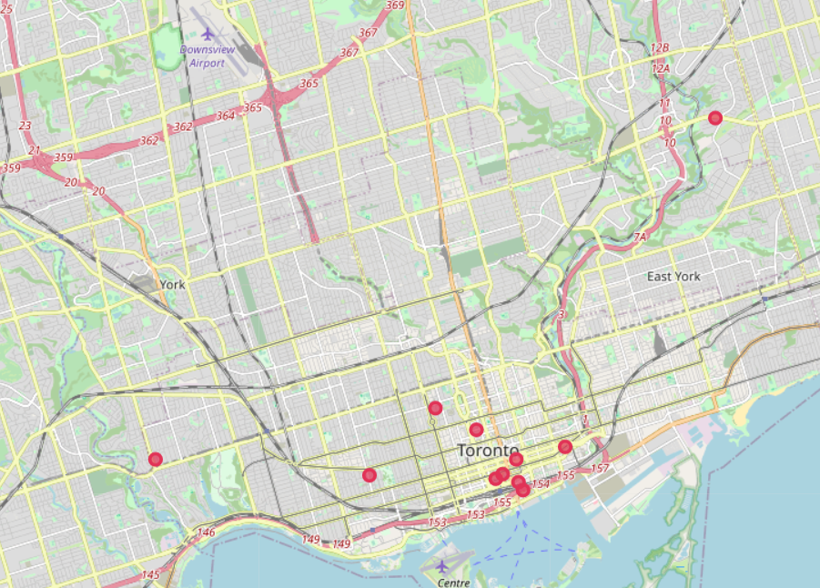
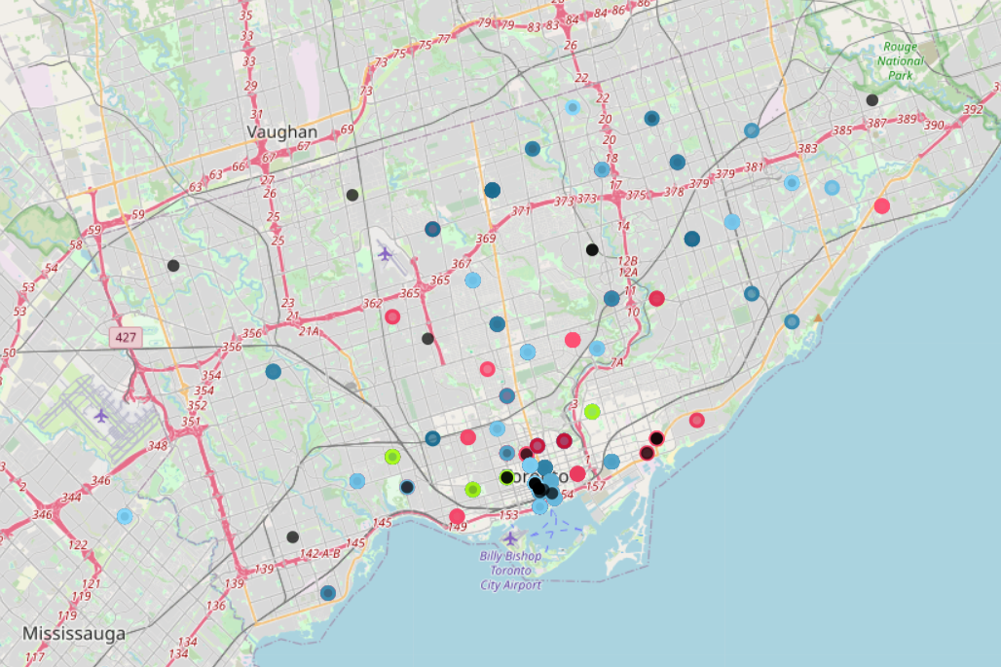
Competition
Direct competition increases as the distance to the airport decreases.
Restaurant density increases as distance to airport decreases.
French restaurants
All restaurants

Slide 4
SOLUTION
Choosing a location further away from the airport is more preferred.

Slide 5
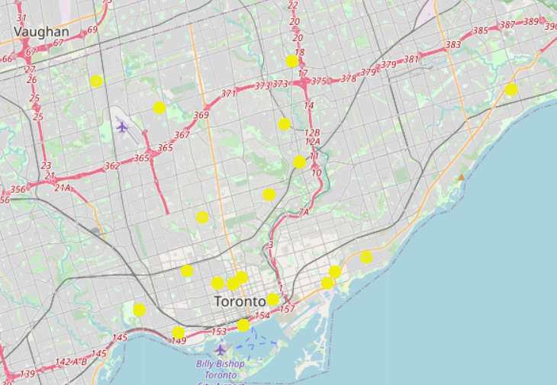
Ability to Accustom to Different Cuisine
If the restaurant opens near restaurants that belong to cluster 1, we expect the competition to be larger. If we open the restaurant near clusters 2,3,5, we expect low competition, but as theses Neighbourhoods are not accustomed to a large variety of cuisine, we expect introducing a new type of cuisine which is uncommon will be difficult.
Cluster 4 consist of neighbourhoods that are not close to the airport.

Slide 6
Population
Most populated Areas
58,293
21.9 km
Fairview, Henry Farm, Oriole
Distant from Airport
Fairview, Henry Farm and Oriole has the highest population.
Neighbourhood is distant from Airport

Slide 7
Highest OPPORTUNITY
58,293
8
Population
0
Most common cuisines
Competition
Populated
Used to different cuisine
No direct competition
Neighbourhoods are populated
8 types of most common cuisine
No French restaurant nearby

Slide 8
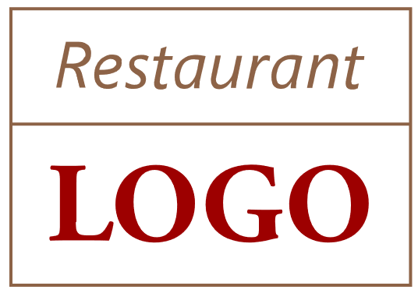
SUMMARY
Combining all the aspects discussed above, Fairview, Henry Farm and Oriole are far from the airport and other French cuisine competitors, people have a larger chance to accustom to different cuisine, and the highest population in the chosen cluster, they are the best choice to consider for opening a French restaurant.

Slide 9
THANK YOU!

